Slide 1



Best Practices Social Roadmap from American Marketing Association:
How Organizations Use SharePoint & Online Communities
© 2012 Telligent. All rights reserved.

Slide 2

What’s the buzz about online communities?
A community is an online hub where people with shared interests can communicate, get support, build relationships and be recognized using popular social media applications.
© 2012 Telligent. All rights reserved.
Notes:
Introductions

Slide 3

The advantages of building social online communities for a business are abundant
Increase brand awareness
Drive sales
Reduce operating costs
Build customer, partner and member relationships
Establish thought leadership
The question remains…how do you actually accomplish these business goals with an online community?
© 2012 Telligent. All rights reserved.
Notes:
Introductions

Slide 4



Take it from:
American Marketing Association
AMA is the professional association for individuals and organizations who are leading the practice, teaching and development of marketing worldwide. Here’s a rundown of its core objectives.
Connect
Serve as a conduit to foster knowledge sharing
Inform
Provide resources, education, career and professional development opportunities
Advance
Promote/support marketing practice and thought leadership
© 2012 Telligent. All rights reserved.
Notes:
Introductions

Slide 5
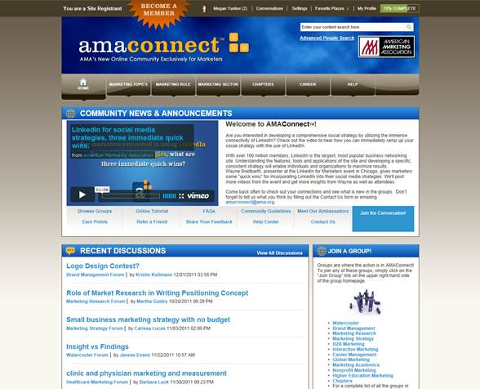
AMA built an online community to layer social interactions into its website and business processes
AMA wanted to connect nationally-distributed members with social networking and content-rich discussions and engagement
Its solution?
Create an online community with verified members to enable member networking and communication, offer exclusive research and share thought leadership on an interactive website.
© 2012 Telligent. All rights reserved.
Notes:
Introductions

Slide 6

Here’s your social business roadmap from AMA and tips for your organization to flourish
Create a strategy
Integrate your social investments
Learn the difference between social media and an online community
Take your cue from AMA’s lessons learned
© 2012 Telligent. All rights reserved.
Notes:
Introductions

Slide 7

1. Create a strategy
Understand your business objectives before you get going.
  Then write up community requirements, such as integrations and analytics, to find the right solution.
Assemble an internal team to evaluate your business requirements. Social impacts your customers, internal departments, board of directors and more, so make sure the right people are on board from day one.
Think through your content plan.
  An online community should drive deeper engagement with, and add value for, your customers, employees, partners and/or members.
Understand how community integrates with your business.
Community works best when it’s not just a standalone application, but integrated with your business process and tools. For AMA, that meant seamless integration with its CMS, Microsoft SharePoint, for document management.
© 2012 Telligent. All rights reserved.
Notes:
Introductions

Slide 8

2. Integrate your social investments
AMA’s website is built on Microsoft SharePoint and integrated with Telligent Community to layer in social interactions and networking between members for a seamless online member experience.
Social media engagement on Twitter, LinkedIn and Facebook drives members back to AMA’s community.
Check out these quick tips from AMA to unite SharePoint and your online community:
Take advantage of integrated search across your community and website so members can easily find the information they want.
Use widgets to pull in content from other Web properties to your community automatically, such as events and calendars.
Plan how to use all of the extra social features that community adds to your website, and seed content before you open your community so members can easily contribute and talk to peers from the get go.
© 2012 Telligent. All rights reserved.
Notes:
Introductions

Slide 9

3. Learn the difference between social media and an online community
AMA uses SharePoint and Telligent to give its members more value than social media alone through deeper engagement, access to exclusive content and networking with verified marketing peers.
In the words of AMA, there are heaps of different groups and networks for marketers (plus other affinity groups and topics) on social networks like LinkedIn and Facebook. In contrast, an online community gathers top caliber participants in one central area for communication and collaboration.
Community removes the noise – ads, spam, self promotion and irrelevant or unhelpful content in social media – since you own and manage it.
Communities enable deeper engagement with subgroups, a full set of social applications, privacy controls and the ability to own and analyze the data. This improves your organization’s ability to identify needs and deliver on customer, employee or member needs.
© 2012 Telligent. All rights reserved.
Notes:
Introductions

Slide 10

4. Take your cue from AMA’s lessons learned
Go where the people go.
  The most popular ways to engage in AMA’s community include discussion forums, media galleries, scheduled chats and custom profile searches to find colleagues and peers. Stay in tune with where and how your audience likes to interact.
Recognize top contributors with badges and special mentions to show appreciation and encourage participation.
Create a group ambassador program.
  Enlist top participants to volunteer to lead discussions, contribute valuable content and keep conversations going.
AMA makes some content public and some private.
  This incents new members and retains current members with valuable resources and networking with peers. Dues-paying members are also rewarded with access to top quality content that is curated and shared by peers on an ongoing basis.
© 2012 Telligent. All rights reserved.
Notes:
Introductions

Slide 11
Now it’s time to reap the rewards of social
AMA is accomplishing its core business goals to connect its members for high quality networking opportunities and information sharing. Plus, it’s on the cutting edge of marketing trends and communication, which is critical to its mission and target audience.
Here are some of the top business benefits created from an integrated social community and website:
Key business differentiator
AMA offers its members targeted resources and networking opportunities not available anywhere else on the Web, which supports member retention and recruitment goals.
Channel for national chapter engagement
AMA chapters, smaller divisions of the national organization, can create private groups with Web 2.0 tools, which are engaging, cost efficient and easy to manage.
Increased member unity and value add
From college students, to CMOs to international marketers, everyone with a common interest and goal can share information and get value from experts.
© 2012 Telligent. All rights reserved.
Notes:
Introductions

Slide 12






Who is Telligent?
Telligent is the leading provider of social community
software for the enterprise. We power thousands of online communities worldwide. See community in action and learn more about us by watching this video.
Plus, check out these online communities built on Microsoft SharePoint and Telligent Community.
American Marketing Association: marketingpower.com
Cadence: cadence.com/community/
Renault: renault.co.uk
Facebook
@telligent
LinkedIn
YouTube
Google+
© 2012 Telligent. All rights reserved.
Notes:
Introductions

